Slide 1
1 Analysis
Notes:
Analysis (Scanning)
From book:
CFG, Recursive Descent, AST, (Visitor+checker)
From project:
BoCoLa: Scanner, CFG, Recursive Descent, AST

Slide 2
Analysis
What is analysis?
  Syntactic Analysis
    Lexical Analysis
    Scanner
  Contextual Analysis
Tokens
    symbols such as identifiers, literals, operators, keywords, and punctuation.
Notes:
A compiler's basic function is to translate a high-level source program to a low-level object program, but before doing so it must check that the source program is well-formed. (analysis/scanning)
A token is an atomic symbol of the source program; symbols such as identifiers, literals, operators, keywords, and punctuation.

Slide 3
Analysis
Source Program
Syntactic Analysis
Error
Analysis
AST
Contextual Analysis
Error
Concrete AST
Code Generation
Object Program
Notes:
Syntactic analysis – we analyze our syntax (tokens) (collaboration, by, ; , …) if from the list there are no tokens when we get an error and it reports errors in the syntax of the code to the programmer.
Contextual analysis – here we look for the right order of the AST struct. For example move by 1; here is right order, if this order will be like move by2; or by move 2; when it produces an error and reports on errors on the semantics and phrasing to the programmer.

Slide 4
Context-free grammar
Formal grammar notation
Used to construct AST and do the parsing
  Simple recursive decent parser using Extended Backus–Naur Form
Used to map the phrase structure of the source code
Used to check if code is valid
Notes:
In formal language theory, a context-free grammar (CFG), sometimes also called a phrase structure grammar is a grammar which naturally generates a formal language in which clauses can be nested inside clauses arbitrarily deeply, but where grammatical structures are not allowed to overlap.
In computer science, Extended Backus–Naur Form (EBNF) is a family of metasyntax notations used for expressing context-free grammars: that is, a formal way to describe computer programming languages and other formal languages.

Slide 5
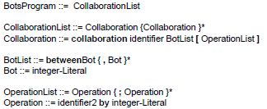
Context-free grammar
Notes:
In formal language theory, a context-free grammar (CFG), sometimes also called a phrase structure grammar is a grammar which naturally generates a formal language in which clauses can be nested inside clauses arbitrarily deeply, but where grammatical structures are not allowed to overlap.
In computer science, Extended Backus–Naur Form (EBNF) is a family of metasyntax notations used for expressing context-free grammars: that is, a formal way to describe computer programming languages and other formal languages.

Slide 6
Syntactic Analysis
Scanner/Lexical Analysis
  Conforms to syntax (symbols, rules, types)
  Phrase structure
Parsing
  Stream of tokens between Scanner and Parsing
  Top-Down and Bottom-Up
We express syntax with context-free grammar
  Normally written in the notation BNF (Backus-Naur Form).
Notes:
The main function of syntactic analysis is to parse the source program in order to discover its phrase structure. Thus the main topic of this chapter is parsing, and in particular the simple but effective method known as recursive-descent parsing.
Lexical Analysis: lexical analysis is the process of converting a sequence of characters into a sequence of tokens. A program or function which performs lexical analysis is called a lexical analyzer, lexer or
scanner.
Scanning (or lexical analysis): The source program is transformed to a stream of tokens: symbols such as identifiers, literals, operators, keywords, and punctuation. Comments, and blank spaces between tokens, are discarded. (They are present in the source program mainly for the benefit of human readers.)
Parsing: The source program (now represented by a stream of tokens) is parsed to determine its phrase structure. The parser treats each token as a terminal symbol.
We can specify the syntax of a programming language formally by means of a context-free grammar. Check if source Conforms to syntax (symbols, rules, types).
Grammars are usually written in the notation BNF (Backus-Naur Form).

Slide 7
Contextual Analysis
Conforms with the contextual constraints
Statically typed and with static binding
  Scope Rules
  Type Rules
  Identification
    identifiers has been declared
    Attributes are correct and used properly
  Type Checking
Notes:
Checks is the source conforms with the contextual constraints (if the code is valid).
For typical programming languages with statically type and with static binding contextual constraints are: Scope Rules, Type Rules, Identification, Type Checking
Scope Rules: These are rules governing declarations and applied occurrences of identifiers.
Type Rules: These are rules that allow us to infer the types of expressions and to decide weather each expression is valid.
Identification: Applying the source lanuage’s sopce rules to relate each applied occurrence of an identifier to its declaration (if any)
Type Checking: applying the source language’s type rules to infer the type of each expression, and compare that type with the expected type.
The first task of the contextual analyzer is to relate each applied occurrence of an identifier in the source program to the corresponding declaration. If there is no corresponding declaration, the source program is ill-formed, and the contextual analyzer must generate an error report.

Slide 8
AST
Build by using tokens (identifiers, methods, reserved symbols)
Abstract structure of source code (what is in source code, but not how is written)
Skip details of real syntax (grouping parentheses, comma and etc.)
Program
Statement
Expression
Statement
Statement
assign
Expression
variable name
y
if (x < y) x = x - y; else y = y - x
Concrete AST is a tree according particular grammar
Notes:
Is used to understand the structure, syntax, phrasing of source code, and is used to create the translation, it must check that the source program is well-formed.
Skips details, Comments, and blank spaces between tokens, are discarded. (They are present in the source program mainly for the benefit of human readers.)

Slide 9
Recursive Descent
Top
Recursive Descent is top-down, left-right process (as deep-first search)
Verify the syntax of input stream
Provides a character a head (know what to expect from input stream)
Node A
Left
Right
Node B
Node E
Left
Left
Right
Right
Node C
Node D
null
Node F
Left
null
Left
Right
Right
Right
null
null
null
null
null
Down
Stack (LIFO)
F
E
D
C
B
A
Right
Left
Notes:
Recursive descent is a parsing method used to translate our source code.
Recursion, programming is a method of defining functions in which the function being defined is applied within its own definition; specifically it is defining an infinite statement using finite components.

Slide 10



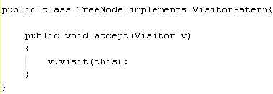
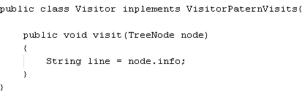
Visitor Pattern
Each tree node has method with parameter of visitor instance
Visitor node has methods with parameters of tree instances
AST
Notes:
Two interfaces for visit() methods another for accept() methods, tree nodes should have accept() method, in visitor class it is implement visit() methods

Slide 11
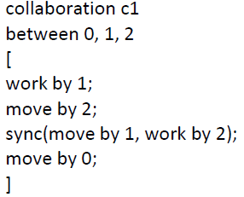

Encoder
Converts information from one format to another
BoCoLa
Java
Java
Notes:
Converts information from one format to another (ACTUAL conversations)

Slide 12
BoCoLa Translation
Language Definition
Defined tokens
Create BoCoLa AST
Concrete BoCoLa example
Concrete BoCoLa AST
Visitor Pattern and Code Generation
Modification of runtime system
Extension of synchronization
Results

Slide 13
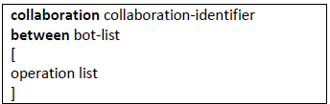
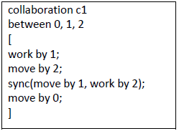
BoCoLa Language Definition
Collaboration abstraction – definition of what should be, reduce (or skip) the information how it is done
Extend BoCoLa with keyword sync:
Semantics: consist of two methods (method could be “work” or “move”), and these methods could be executed by bot(s) n
Contextual constrains: methods could be the same or different as well as bot number n, bot number n should be described in bot list

Slide 14
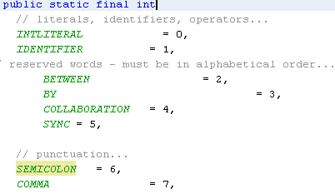
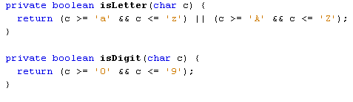
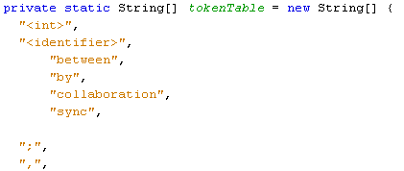
BoCoLa Defined Tokens
Tokens:
  between, by, collaboration, ;, [, ], EOF, …
Token.java class
Scanner.java class
Notes:
Token.java – in this class we defined all BoCoLa tokens
Scanner.java class is general rules to create tokens (it could be used Regex)

Slide 15
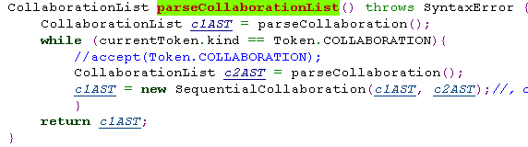
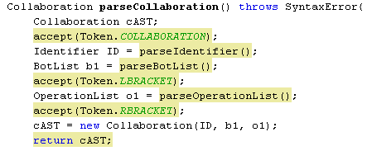
BoCoLa AST
Parser.java class
Sequential Collaboration
…
…
Collaboration ID
…

Slide 16
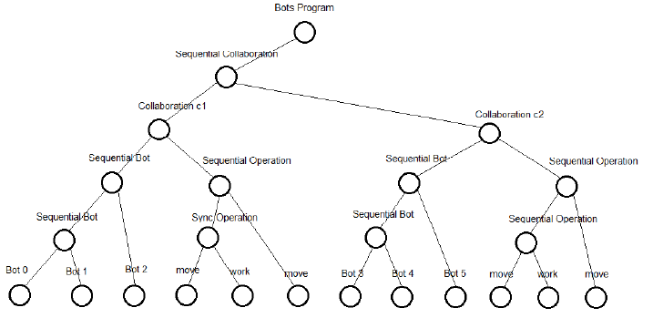
Concrete BoCoLa AST
Bots Program
Sequential Collaboration
Collaboration
Sequential Bot
Sequential Operation
move/work
Bot

Slide 17
Concrete BoCoLa example
(Translation)
BoCoLa
Java
Java
Language | Syntax
BoCoLa | collaboration c1 between 0, 1, 2 [ sync(move by 1, work by 2); move by 0; ] collaboration c2 between 3,4,5 [ move by 5; work by 3; move by 4; ]
Java | Collaborations[No] = new Collaboration(); { Collaborations[No-1].include(new BotMethod.botMove(),Bot.bots[1],new BotMethod.botWork(),Bot.bots[2]); Collaborations[No-1].include(new BotMethod.botMove(),Bot.bots[0]); } Collaborations[No]=new Collaboration(); { Collaborations[No-1].include(new BotMethod.botMove(),Bot.bots[5]); Collaborations[No-1].include(new BotMethod.botWork(),Bot.bots[3]); Collaborations[No-1].include(new BotMethod.botMove(),Bot.bots[4]); }

Slide 18
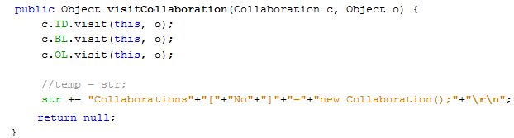

Visitor Pattern and Code Generation
Each tree node has method with parameter of visitor instance
Visitor node has methods with parameters of tree instances
Encoder.java
Generate code from BoCoLa to Java, by using Java
BoCoLa
Java
Java

Slide 19
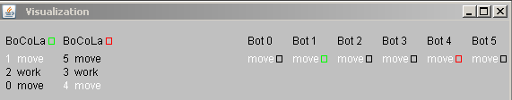
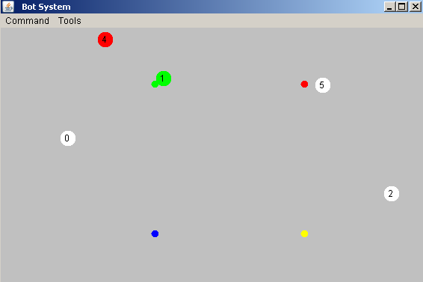
Results
Notes:
Picture of the Bots System runtime. Here are collaborations between bots.
By using the keyword sync it takes longer to execute, because of the wait. During synchronized bot execution no other bots execute. This guarantee right order of bots execution (move or/and work).

